Slide 1
AIBridge
Lecture 9
Notes:
add outline

Slide 2
So we learned about LLMs like ChatGPT.
But what about media generation?

Slide 3
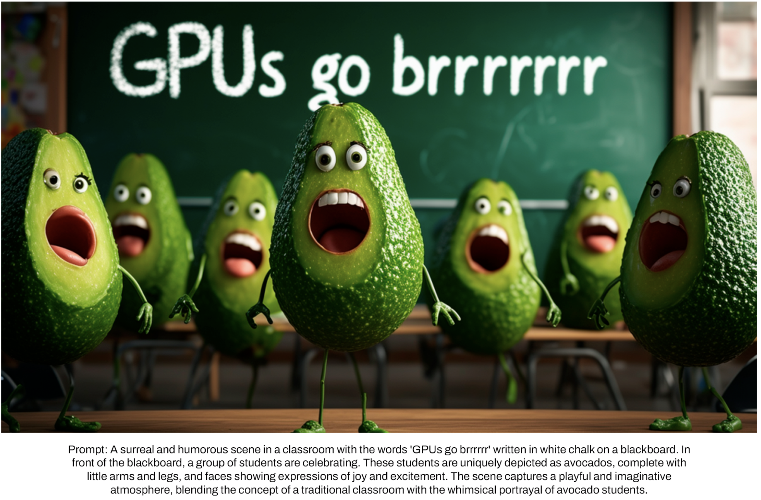
Are the ones in the back larger?
Notes:
slow down and talk about what this is and do a live demo
dont assume people know about it

Slide 4
Probabilistic Output
0.9
0.05
0.03
0.02
This one!
Text input
GPT
This is how ChatGPT works.
This vector is about 100,000 in size.
(annoying but manageable to calculate)
Notes:
This is a very critical concept. This is why ChatGPT generates different answers if you try at multiple times. This is also the generation part. Why it is not “accurate”. It is not supposed to be ”accurate”. It meant to mimic human language.

Slide 5
Does this work for images?
0.04
0.02
0.1
0.84
Model
Previous RGB
Seems good right?
This vector is about 250 in size.
Notes:
This is a very critical concept. This is why ChatGPT generates different answers if you try at multiple times. This is also the generation part. Why it is not “accurate”. It is not supposed to be ”accurate”. It meant to mimic human language.
change to 0.84.

Slide 6
Does this work for images?
Pictures have different boundaries and styles.
Well, not exactly…
0.04
0.02
0.1
0.84
Model
Previous RGB
How does a prompt play in here?
Pixels can’t really be ordered.
Notes:
This is a very critical concept. This is why ChatGPT generates different answers if you try at multiple times. This is also the generation part. Why it is not “accurate”. It is not supposed to be ”accurate”. It meant to mimic human language.

Slide 7
We’re going to have to change approaches.
So do we have any advantages?

Slide 8
Colors are continuous, words are not.

Slide 9
Colors are continuous, words are not.
(68, 114, 196)
(68, 114, 197)

Slide 10
Colors are continuous, words are not.
(68, 114, 196)
Small change
Small difference
(68, 114, 197)

Slide 11
Colors are continuous, words are not.
(68, 114, 196)
(10, 13, 26, 11)
Hi, how can you?
(10, 13, 25, 11)
Hi, how are you?
Small change
Small difference
(68, 114, 197)

Slide 12
Colors are continuous, words are not.
(68, 114, 196)
(10, 13, 25, 11)
Hi, how are you?
Large difference
Small change
Small difference
Small change
(68, 114, 197)
(10, 13, 26, 11)
Hi, how can you?

Slide 13
Colors are continuous, words are not.
(68, 114, 196)
(91, 180, 178)
(121, 255, 159)
And therefore so are images.

Slide 14
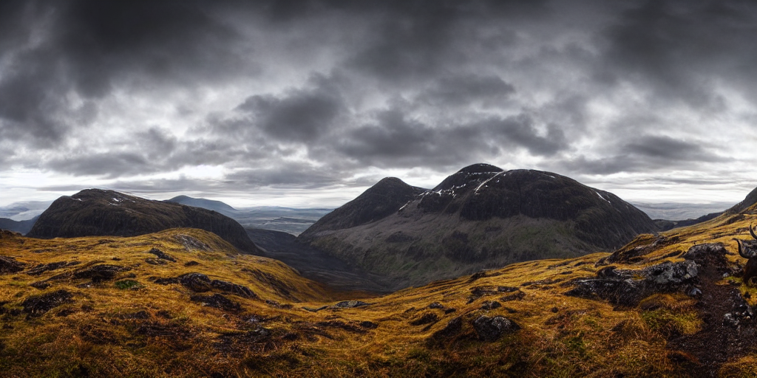
Prompt
Model
Prompt

Slide 15
Prompt
Model
Use random pixels
(Forget the prompt for now)

Slide 16
Look like an image
Our goal:
Random noise
Coherent image
Remember that we can do this in steps.
Notes:
motivate random noise
its magical and ask "can you think of any way?"

Slide 17
Look like an image
Let’s think about the reverse process from a sample and generating each step.
For math simplicity, RGB values [0,255] will be mapped to [-1, 1].

Slide 18
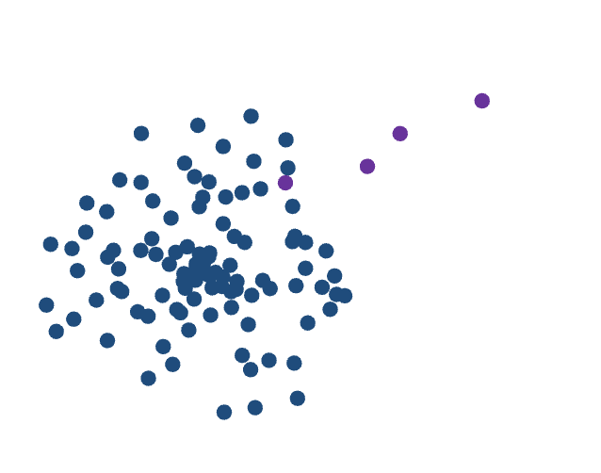
Look like an image
We are using simplified notation that may not reflect what is used elsewhere.
$β_{t}$ noise
$$x_{0}$$
. . . . . .
$$x_{t}$$
$$x_{t+1}$$
$$x_{T}$$
High density to low density
gives us the name of
Forward Diffusion
Samples
Notes:
expand on diffusion.

Slide 19
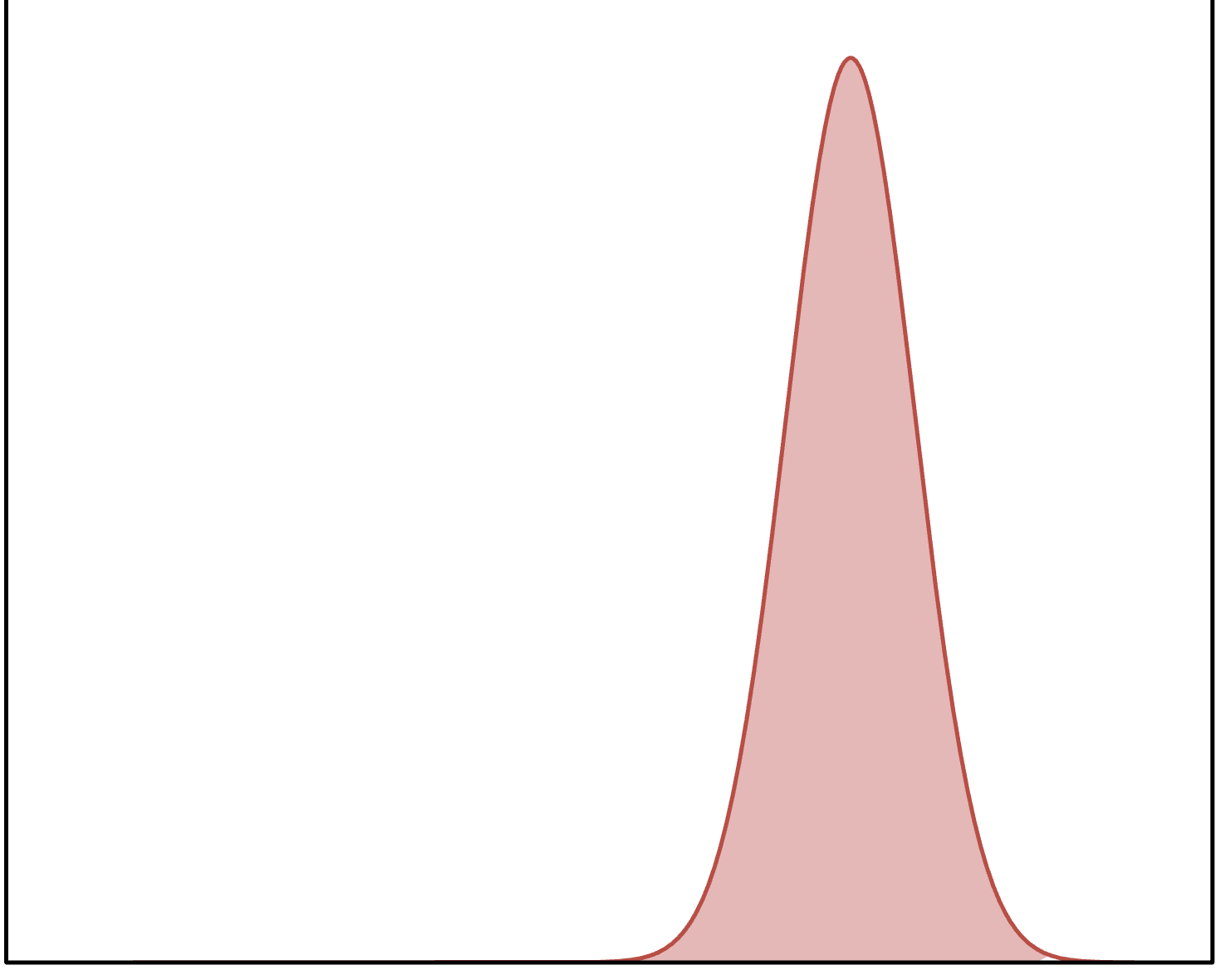
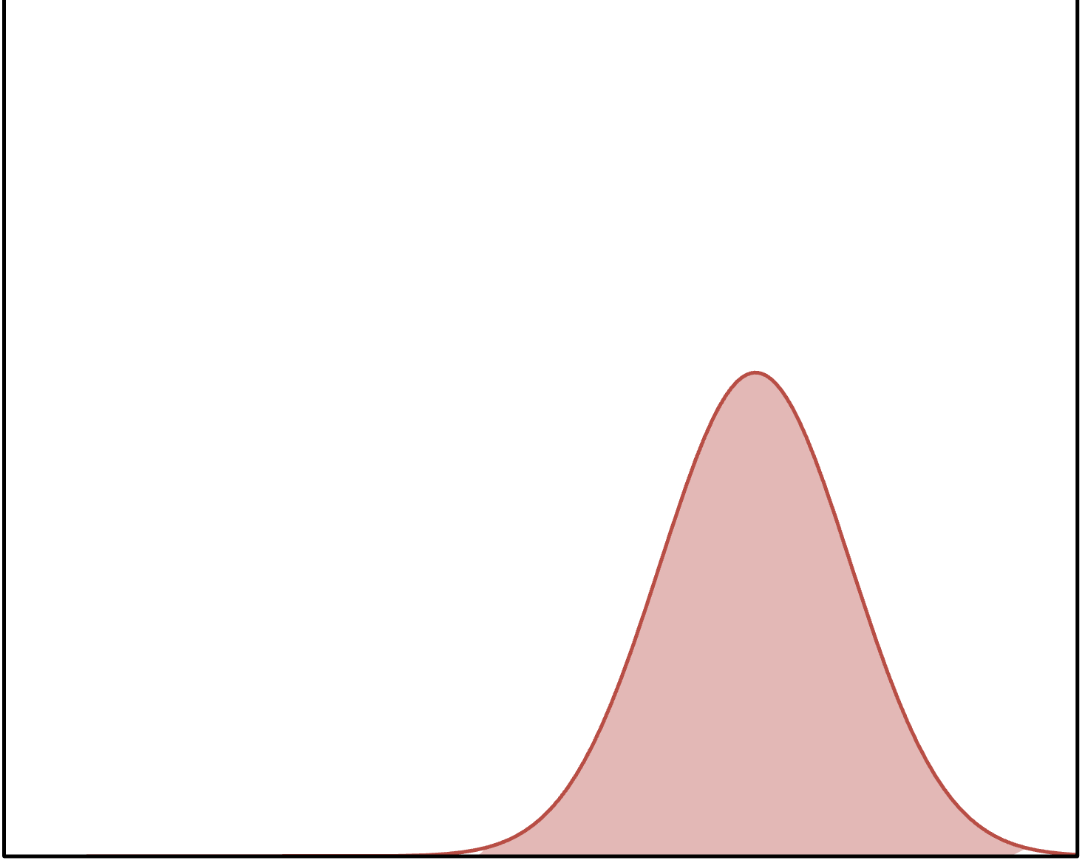
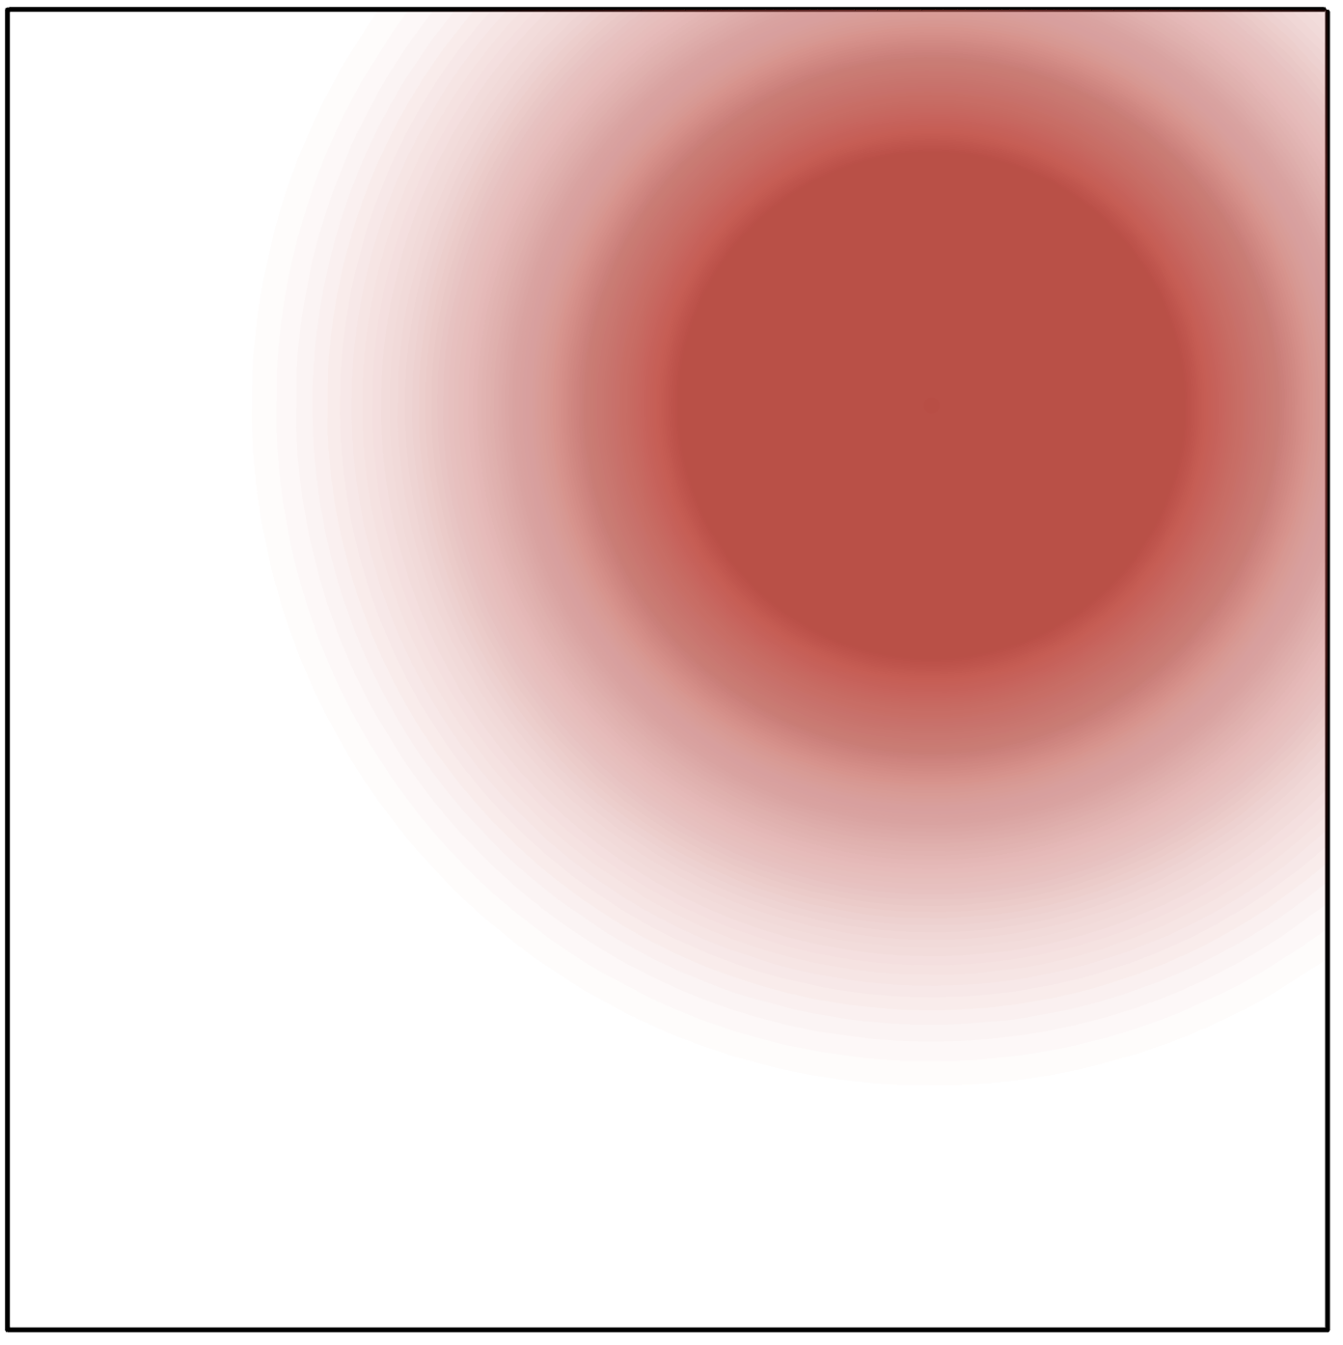
Look like an image
Forward Diffusion
Each step is not a specific image, but is a probability distribution.

Slide 20
Look like an image
Forward Diffusion
We are using simplified notation that may not reflect what is used elsewhere.
$β_{t}$ noise
$$x_{0}$$
. . . . . .
$$x_{t}$$
$$x_{t+1}$$
$$x_{T}$$
$$x_{t+1}=N(\sqrt{1−β_{t}}x_{t},β_{t})$$
Gaussian distribution
Sum of gaussians is another gaussian
Each step is not a specific image, but is a probability distribution.

Slide 21
Look like an image
Forward Diffusion
We are using simplified notation that may not reflect what is used elsewhere.
$β_{t}$ noise
$$x_{0}$$
. . . . . .
$$x_{t}$$
$$x_{t+1}$$
$$x_{T}$$
$$x_{t+1}=N(\sqrt{1−β_{t}}x_{t},β_{t})$$
$$x_{t+1}=N(\sqrt{{\overline{a}}_{t}}x_{0},1−{\overline{a}}_{t})$$
$$α_{t}=1−β_{t}$$
$${\overline{a}}_{t}=\prod_{0≤i≤t}{a_{t}}$$
Sum of gaussians is another gaussian
Each step is not a specific image, but is a probability distribution.
Notes:
talk about intuition first
add more distribution stuff

Slide 22
Look like an image
$β_{t}$ noise
$$x_{0}$$
. . . . . .
$$x_{t}$$
$$x_{t+1}$$
$$x_{T}$$
Our models $M_{t}$
Reverse Diffusion

Slide 23
Look like an image
Reverse Diffusion
$$M_{t}$$

Slide 24
Look like an image
Reverse Diffusion
We can generate these on demand
$β_{t}$ noise
$$x_{0}$$
. . . . . .
$$x_{t}$$
$$x_{t+1}$$
$$x_{T}$$
Our models $M_{t}$
So we can use them to train our models!

Slide 25
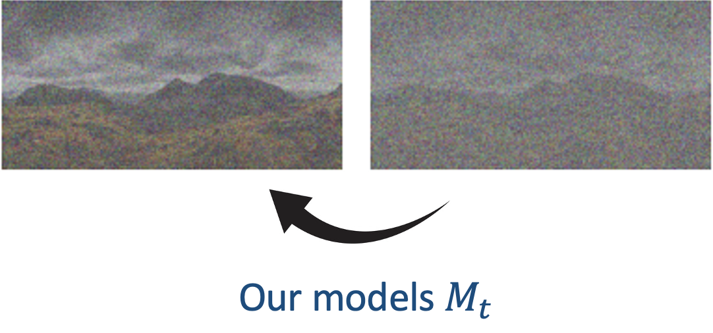
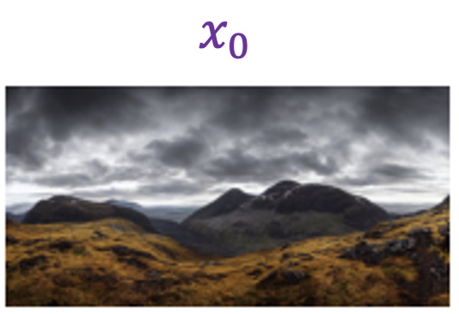
Look like an image
Reverse Diffusion
Process:
Neural Networks
For each model $M_{t}$
For each image $x_{0}$
Generate samples $x_{t}$ and $x_{t+1}$
Use samples to train $M_{t}$

Slide 26
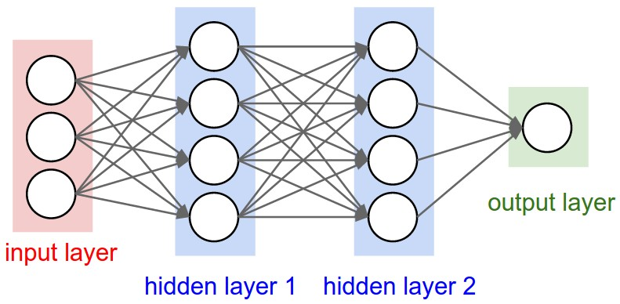
Neural Networks
“It’s inspired by the brain”
“The edge weights are tuned with data”
But what does that mean?
Notes:
Been around for 80 years, made useful in the last 10 ish
Make bigger picture summarize "neurons in computer = small piece of the algorithm that works together to "

Slide 27
Neural Networks
“It’s inspired by the brain”
Neurons take input from other neurons
“The edge weights are tuned with data”
We’ll get to this later
But what does that mean?

Slide 28
Neural Networks
Neurons take input from other neurons
Each neuron has an activation level $a_{i}$
$E_{i}$ is the set of incoming edges
$$a_{i}=f(\sum_{j∈E_{i}}{w_{j,i}⋅a_{j}})$$
Sum up contribution from each incoming edge
Run it through the activation function
Notes:
Typically the same activation function for all hidden nodes and a different one for output nodes

Slide 29
Neural Networks
Neurons take input from other neurons
$$a_{i}=f(\sum_{j∈E_{i}}{w_{j,i}⋅a_{j}})$$
Notes:
Typically the same activation function for all hidden nodes and a different one for output nodes

Slide 30
Neural Networks
Neurons take input from other neurons
$$a_{i}=f(\sum_{j∈E_{i}}{w_{j,i}⋅a_{j}})$$
Notes:
Typically the same activation function for all hidden nodes and a different one for output nodes

Slide 31
Neural Networks
Neurons take input from other neurons
$$a_{i}=f(\sum_{j∈E_{i}}{w_{j,i}⋅a_{j}})$$
Feedforward neural network
Notes:
Typically the same activation function for all hidden nodes and a different one for output nodes

Slide 32
Neural Networks
Universal Approximation Theorem:
a NN with a nonpolynomial activation function can approximate ANY function
For any task, a neural network exists for the job
No guarantees of how to find the neural network

Slide 33
Neural Networks
Backpropagation
We know exactly how changing this affects cost
Notes:
“Recent” breakthrough

Slide 34
Neural Networks
Backpropagation
We know exactly how changing this affects cost
So we know how these edges affect cost
Notes:
“Recent” breakthrough

Slide 35
Neural Networks
And these nodes
Backpropagation
We know exactly how changing this affects cost
So we know how these edges affect cost
Notes:
“Recent” breakthrough

Slide 36
Neural Networks
And these nodes
Backpropagation
We know exactly how changing this affects cost
And so on
So we know how these edges affect cost
And these edges
Notes:
“Recent” breakthrough

Slide 37
Neural Networks
Backpropagation
And so on
Tweak them all a bit and repeat
Notes:
“Recent” breakthrough

Slide 38
Look like an image
Reverse Diffusion
Process:
For each model $M_{t}$
For each image $x_{0}$
Generate samples $x_{t}$ and $x_{t+1}$
Use samples to train $M_{t}$
How do we make an image with a prompt?

Slide 39
$β_{t}$ noise
$$x_{0}$$
. . . . . .
$$x_{t}$$
$$x_{t+1}$$
$$x_{T}$$
Our models $M_{t}$
Add something to try to go toward the prompt
Conditional Diffusion Model

Slide 40
the prompt
This can vary in length!
How do we make it one size?
Latent spaces

Slide 41
Latent spaces
(one last detour)
A representation in which similar items are physically close
“I want coffee”
“I want tea”
“Apes are smart”

Slide 42
Latent spaces
(one last detour)
A representation in which similar items are physically close
“I want coffee”
This is how text-based AI works, but the exact formula for modern commercial models isn’t public
“I want tea”
“Apes are smart”

Slide 43
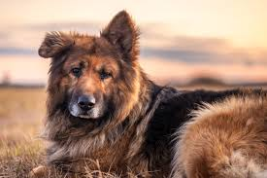
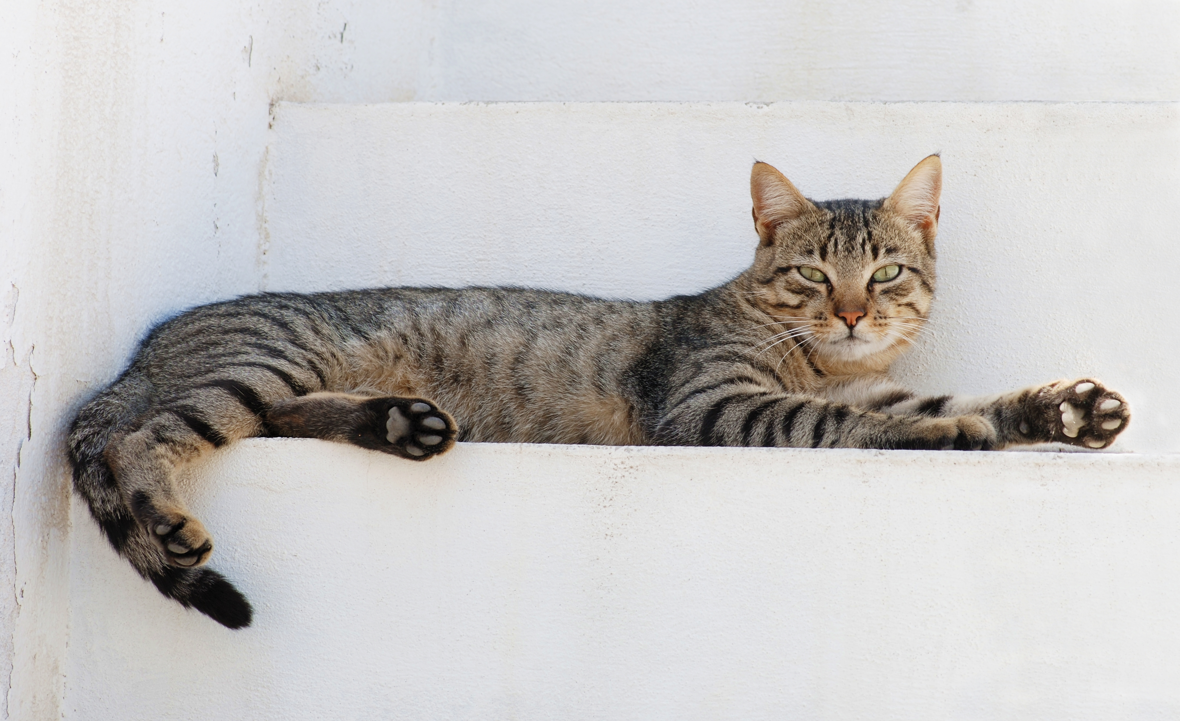
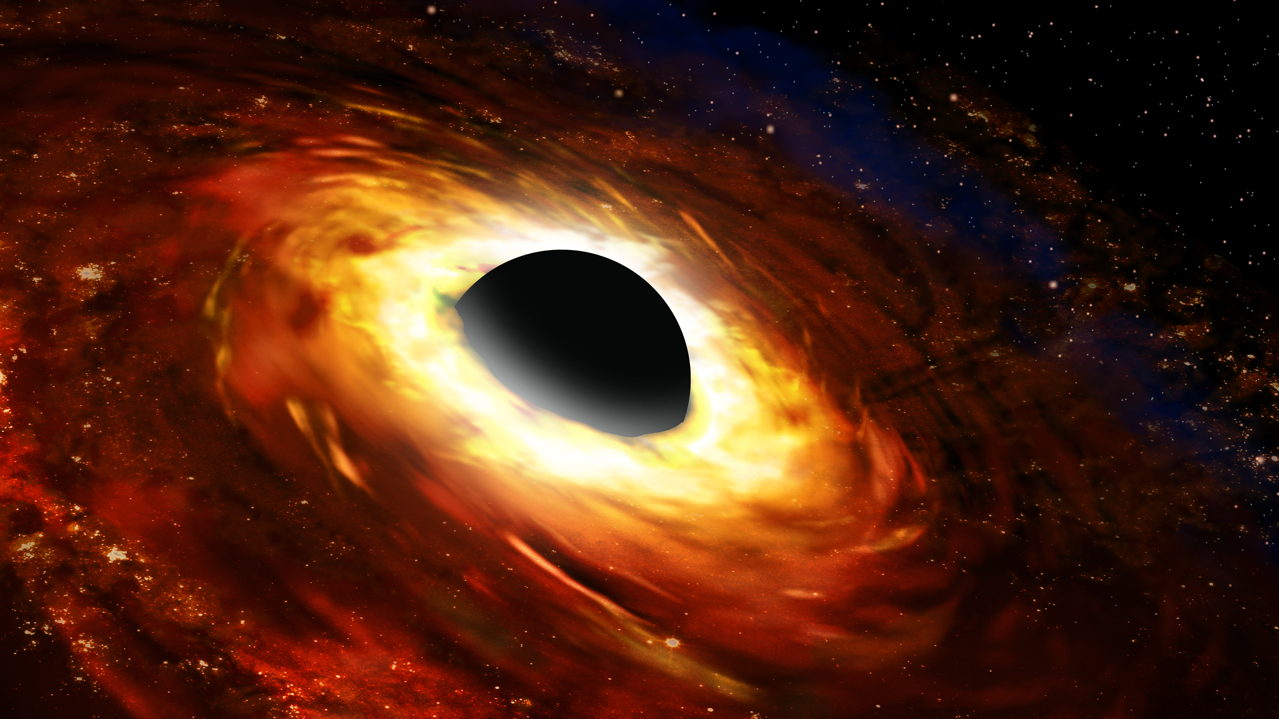
Latent spaces
(one last detour)
A representation in which similar items are physically close
This is how text-based AI works, but the exact formula for modern commercial models isn’t public
It also works for images, to try to make meanings clearer for the model and to reduce dimensions

Slide 44
$β_{t}$ noise
$$x_{0}$$
. . . . . .
$$x_{t}$$
$$x_{t+1}$$
$$x_{T}$$
Our models $M_{t}$
Add something to try to go toward the prompt
Conditional
Diffusion Model

Slide 45
$β_{t}$ noise
$$x_{0}$$
. . . . . .
$$x_{t}$$
$$x_{t+1}$$
$$x_{T}$$
Our models $M_{t}$
Add something to try to go toward the prompt
Conditional Latent Diffusion Model
Conditional
Latent
Diffusion Model

Slide 46
Conditional Latent Diffusion Model
Text input
Model
Notes:
Just like GPT, it mimics how real pictures look and may have inaccuracies if it tries to convey something

Slide 47
Limitations
Details are an issue.
Datasets are biased.
(more on this later)

Slide 48
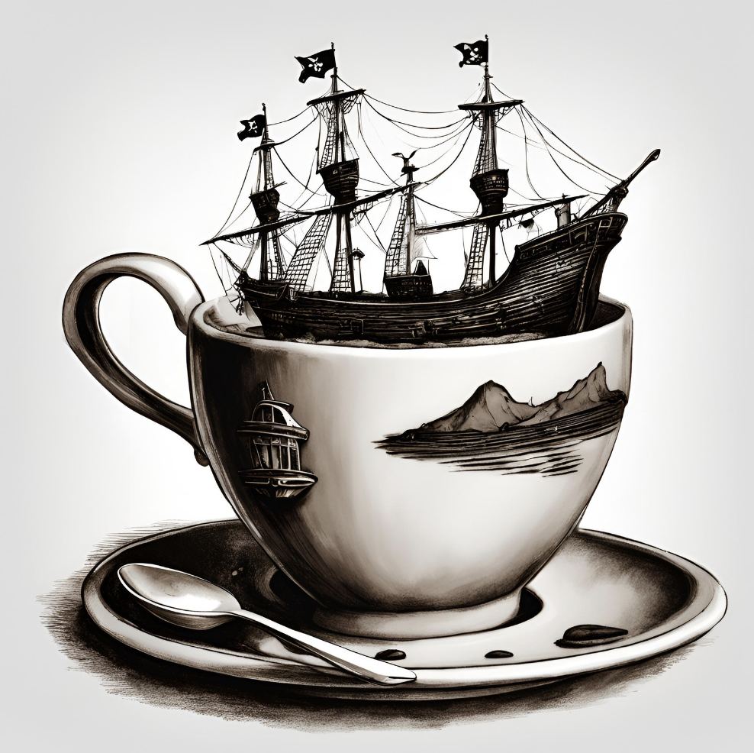
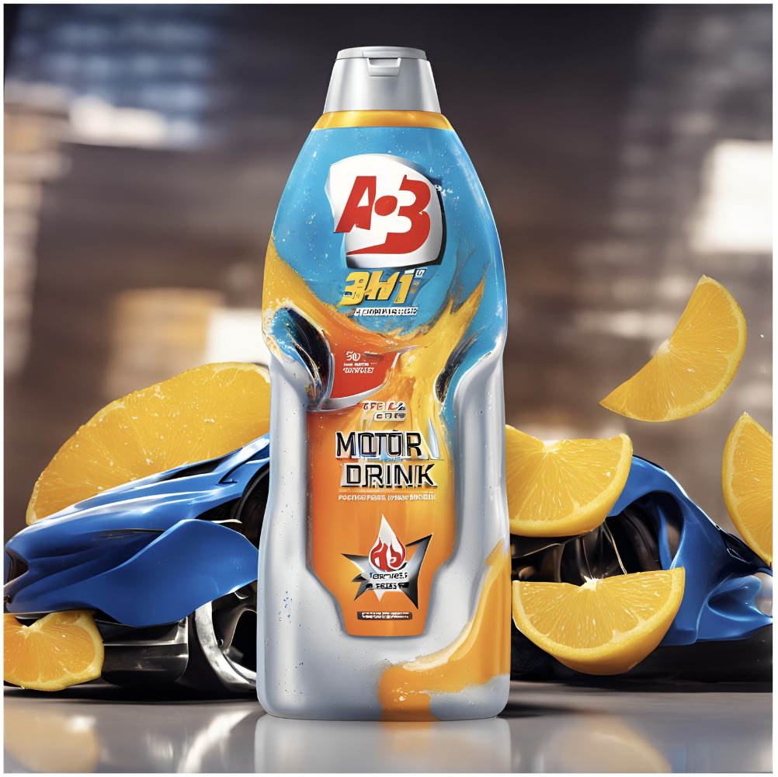
Use cases
Text to image or text to video
A pirate ship in a coffee cup
An advertisement for a 3 in 1 body wash, motor oil, and energy drink
Bizarre scenarios for entertainment
Advertisement streamlining

Slide 49
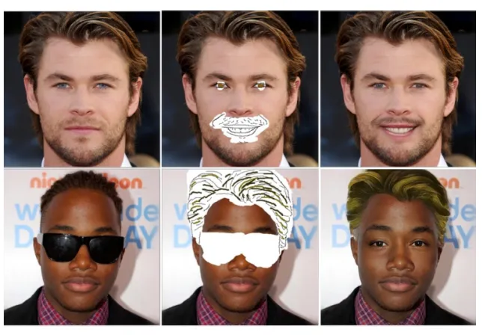
Use cases
Image inpainting (filling in details)

Slide 50
Use cases
Image outpainting (expanding beyond borders)
And many more …

